Slide 1

Smart Campus Management Platform Using Cloud-Native Microservices
CNAD Project Review-2
29-08-26
 | Under the Guidance of Dr. Patha Srilatha Associate Professor Department of CSE, KLH CSE Bowrampet Campus
Team Members PRANAV MAHAJAN-2420030727 B.SRIJAN-2420030201

Slide 2
Outline of Project Work
Focus
Introduction
Literature Survey
Challenges
Research Objectives
Conclusion & Future Work
References
Publications Details

Slide 3
Problem Statement
Problem Statement
Modern educational institutions manage multiple campus activities such as student information, attendance, academics, faculty services, events, transport, facilities, and communication.
However, these services are often maintained through separate applications and databases, making it difficult to:
Integrate different campus services into a single platform.
Provide real-time access to campus information.
Handle increasing numbers of students, faculty, and administrative users.
Scale individual services based on demand.
Maintain reliable communication between different campus modules.
Monitor system health and service availability.
Secure sensitive student and institutional information.
Update or deploy individual services without affecting the entire application.
Therefore:
There is a need for a unified, scalable, secure, and highly available Smart Campus Management Platform that uses cloud-native microservices to independently manage and integrate different campus services.

Slide 4
Objectives
1. Centralized Campus Management
Develop a unified platform to manage major campus services such as student management, attendance, academics, events, and facilities using microservices.
2. Microservices-Based Architecture
Design independent microservices for different campus functions so that each service can be developed, deployed, maintained, and scaled independently.
3. Cloud-Native Scalability
Utilize cloud-native technologies such as containers, APIs, service communication, and orchestration to support increasing campus workloads.
4. Real-Time Information & Notifications
Provide students, faculty, and administrators with real-time updates regarding attendance, announcements, events, schedules, and campus services.
5. Secure Role-Based Access
Implement authentication and authorization based on user roles such as Student, Faculty, and Administrator.
6. Monitoring & Reliability
Monitor individual services and system performance to detect failures and maintain high availability.
Reduce manual processes and provide a convenient digital platform for students, faculty, and administrators.

Slide 5
Literature Survey
Authors / Source | Title / Area | Methodology | Inferences | Limitation / Future Work
Newman | Building Microservices | Microservices architectural approach | Independent services improve modularity, scalability, and maintainability. | Microservices introduce communication and deployment complexity.
Richardson | Microservices Patterns | Architectural patterns for distributed applications | API gateways, service discovery, database-per-service and event-driven communication support microservice systems. | Requires careful service design and monitoring.
NIST | Cloud Computing / Cloud-Native Concepts | Cloud architecture and security guidelines | Cloud platforms provide scalability, resource flexibility, and availability. | Requires appropriate security and resource management.

Slide 6
Problem Gap Identification
1. Fragmented Campus Services — Primary Focus
Traditional campus applications often manage individual functions separately, such as:
Student management
Attendance
Academics
Events
Facilities
Communication
There is a need for a unified platform where these services can communicate efficiently while remaining independently manageable.
2. Scalability & Availability — Secondary Focus
Monolithic applications can become difficult to scale when the number of users and transactions increases.
There is a need for an architecture where individual services can be independently scaled and deployed according to demand.
Proposed Gap Addressed
The proposed Smart Campus Management Platform addresses these gaps by using a cloud-native microservices architecture that integrates campus services while providing scalability, modularity, security, and reliability.

Slide 7
Innovation, Creativity, and Novelty
1. Microservices-Based Smart Campus
Campus functions are divided into independent services such as Student, Attendance, Academic, Event, Notification, and Facility Management.
2. Independent Scalability
Each microservice can be scaled independently based on its workload instead of scaling the complete application.
3. API Gateway-Based Integration
A centralized API Gateway provides a common entry point for users and manages communication between clients and backend services.
The platform provides customized functionality for based on their roles and permissions:
  Student → Faculty → Administrator
4. Centralized Monitoring
Service health, performance, errors, and availability can be monitored across the microservices environment and Failure of one service should not bring down the entire campus platform, improving system reliability.
5. Cloud-Native Deployment
Containerization and orchestration can be used to deploy and manage services efficiently in a cloud environment.
Proposed Workflow
User Request → API Gateway → Microservice → Database / Service → Response → Notification / Monitoring

Slide 8
Feasibility and Project Plan
Technical Feasibility
Microservices can be implemented using technologies such as Java Spring Boot / Node.js / Python.
REST APIs can enable communication between services.
Docker can be used for containerization.
Kubernetes can be used for container orchestration.
Cloud platforms can provide deployment and scalability.
Operational Feasibility
Students can access campus services through a centralized interface.
Faculty can manage academic and student-related activities.
Administrators can monitor and manage campus operations.
Economic Feasibility
Open-source technologies can reduce development costs.
Cloud resources can be scaled according to actual requirements.
Independent services reduce the cost and risk of modifying the complete system.

Slide 9
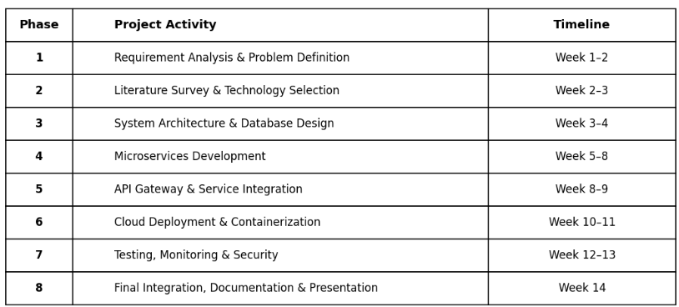
Feasibility and Project Plan

